Slide 1

RIO DE JANEIRO RACE PREVIEW
Elite Analysis · August 1 – 2, 2026
USA Triathlon High Performance

Slide 2
Race Week Schedule
Rio de Janeiro
August 1 – 2, 2026 • Triathlon Arena, Copacabana Beach, Av Atlântica (BRT, UTC-3)
Sat • Aug 1
Sun • Aug 2
Familiarization & Briefing
WORLD CUP RACE DAY
08:00 – 08:45 | Bike course familiarization — Triathlon Arena
09:00 – 09:45 | Swim course familiarization — Triathlon Arena
16:00 – 17:00 | ★ Mandatory Elite Athletes' briefing — Othon Palace
Post-briefing | Race pack + credentials distribution
05:30 – 06:30 | Elite Women — Athletes' lounge open
05:30 – 06:45 | Elite Women — Transition open
06:20 – 06:45 | Elite Women — Swim course open for warm-up
06:50 – 06:58 | Elite Women — Presentation
07:00 | ★ ELITE WOMEN RACE START
06:45 – 08:45 | Elite Men — Athletes' lounge open
08:00 – 08:45 | Elite Men — Transition + swim warm-up
08:50 – 08:58 | Elite Men — Presentation
09:00 | ★ ELITE MEN RACE START
10:30 | Elite Men & Women medal ceremony
Times Triathlon Arena, Copacabana Beach, Av Atlântica (BRT, UTC-3). Schedule confirmed from World Triathlon race-info page / athlete guide; subject to organiser updates.

Slide 3
Key Course Differentiators
Rio de Janeiro
RIO DE JANEIRO
COURSE AT A GLANCE
The World Triathlon Cup returns to Copacabana Beach — the 2016 Olympic triathlon venue — for a sprint-distance race on August 2. A beach-start 750 m ocean swim in Atlantic surf feeds a dead-flat, fast 20.8 km bike along Avenida Atlântica and a 2-lap, 5 km run down the iconic Copacabana promenade. Warm 22–24 °C water means a non-wetsuit swim; the flat swim-and-bike put the whole race on the run. Morning starts (Women 07:00, Men 09:00) in Rio's mild August winter.
Swim:
750 m – 1 lap
Bike:
20.8 km – 6 laps × 3.47 km
Run:
5 km – 2 laps × 2.5 km
Format:
Sprint Triathlon (World Cup)
COURSE FEATURES
Bike Laps:
6
Run Laps:
2
• Beach-start 750 m ocean swim off Copacabana — Atlantic surf entry, non-wetsuit (22–24 °C).
QUICK LINKS
• Flat & fast 20.8 km bike (6 laps) along the Avenida Atlântica seafront — big packs, high speed.
Current Race Info:
Race Info | 2026 World Triathlon Cup Rio de Janeiro
• 5 km run (2 laps) on the iconic Copacabana promenade — flat and fast; this is where it's decided.
• 2016 Olympic venue; morning starts (W 07:00 / M 09:00) in mild Rio winter conditions.

Slide 4
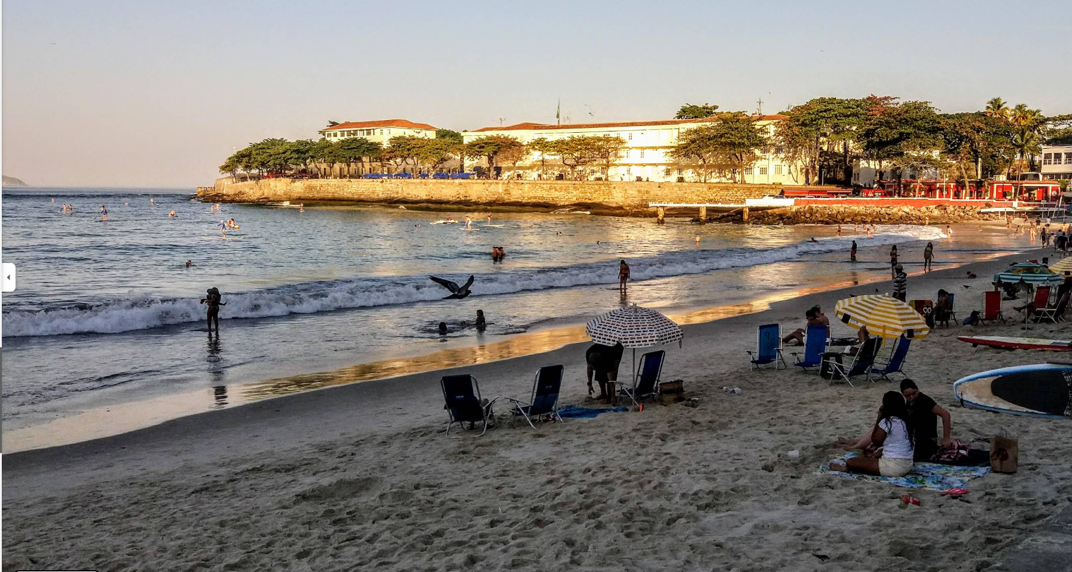
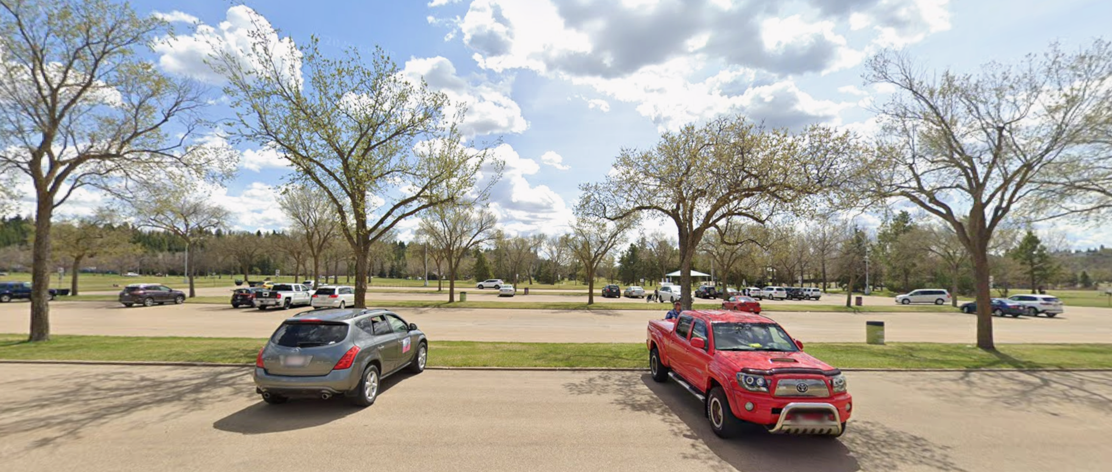
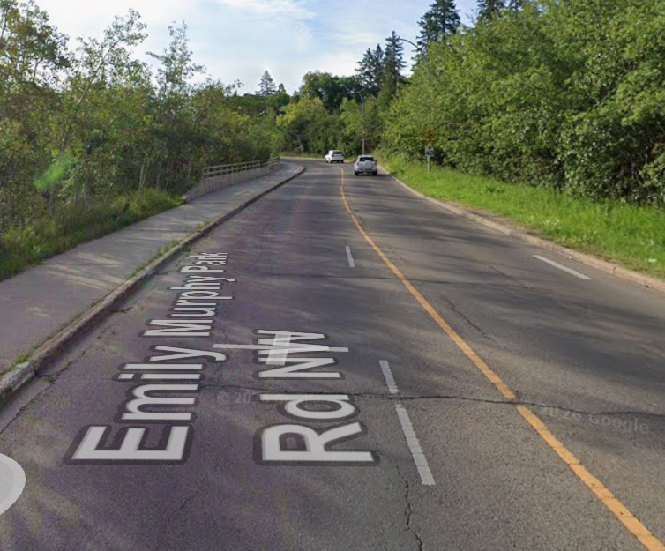
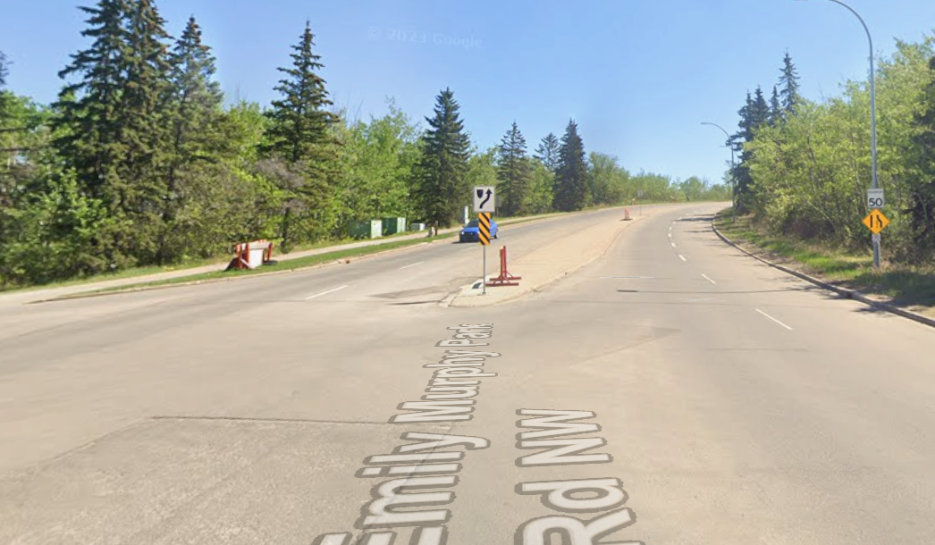
Course Photos
Edmonton
Swim Area
Transition
Beginning of Bike Climb
Halfway / End of Bike Climb

Slide 5
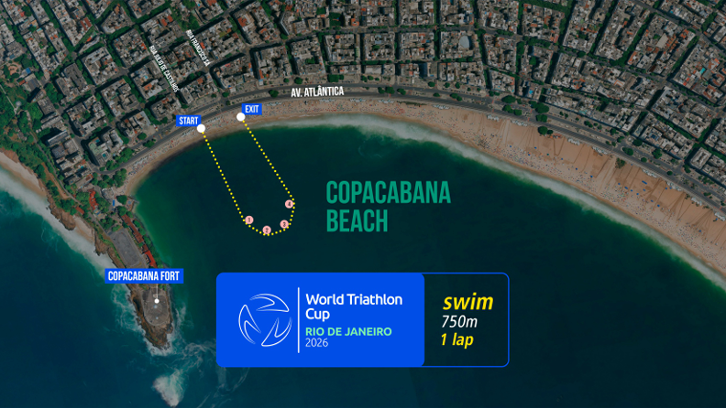
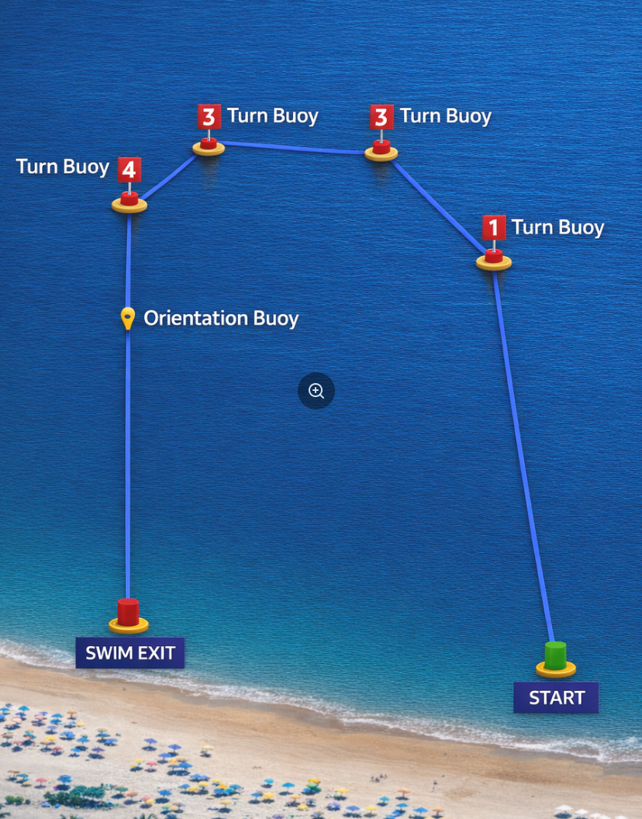
Swim Course Profile
Rio de Janeiro
750 m • single lap
Open ocean — Atlantic surf, beach start
Distance
Layout
Start
750 m
Copacabana Beach
Beach start
[Drop swim course map here] Save the organiser map as: ppt files/support/rio de janeiro_swim_course.png It will be embedded automatically on the next run.
Water Temp
Wetsuit
Lap Count
22.5 °C (live)
Forbidden (> 22 °C)
1
Tactical Notes
• Single 750 m counterclockwise ocean loop off Copacabana Beach. Same course as the 2016 Olympic swim venue
• Beach start with some potential for ocean swell and chop. Protection from the fort and pier though tends to lead to calmer conditions.
Source: 2026 World Triathlon Cup Rio Athlete's Guide v2.0 (Copacabana)
• Warm water (22–24 °C). Prepare for non-wetsuit and to manage potential warm water and air temps.
• Exit is close to the entry point. Run up the beach to transition

Slide 6
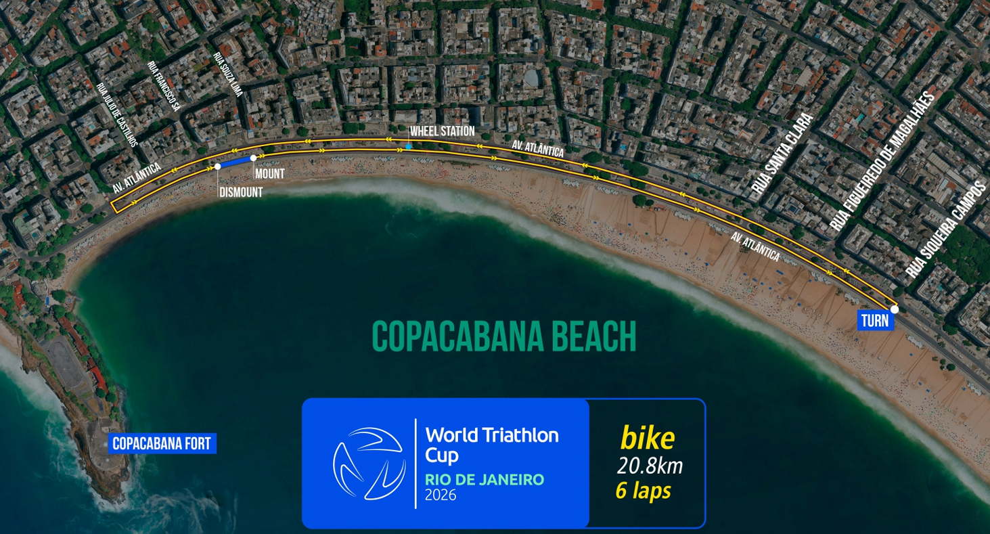
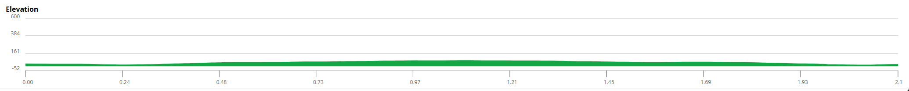
Bike Course Profile
Rio de Janeiro
20.8 km • 6 × 3.47 km loops
Closed seafront circuit — Avenida Atlântica, Copacabana
[Drop course map here] Save the organiser course map as: ppt files/support/rio de janeiro_bike_course.png It will be embedded automatically on the next run.
Elevation / Lap
Total Climb
Avg Grade
65 ft / lap
390 ft
0%
Max Climb Grade
Wind
Loops
—
Beachfront exposed
6 × 3.47 km
Tactical Implications
• Fast and flat: 6 counterclockwise laps along the Copacabana seafront (Avenida Atlântica) = 20.8 km
Source: 2026 World Triathlon Cup Rio Athlete's Guide v2.0 (Copacabana)
• Classic beachfront out-and-back — the same waters/roads that hosted the 2016 Olympic triathlon
• Dead-flat, high-speed course built for spectators; expect large lead packs and a bunch finish onto the run
• Sea-breeze exposure along the beachfront straights can shape pack dynamics into the turns
• NOTE: guide is internally inconsistent — header says 20.8 km / 6 laps, body text says 20 km / 4 × 5 km. Confirm final lap count at briefing.
Flat course — published profile shows no significant climbs. No elevation chart synthesized; if a race GPS FIT becomes available, real contours will replace this block.

Slide 7
Run Course Profile
Rio de Janeiro
5.0 km • 2 × 2.5 km
Paved seafront promenade — Avenida Atlântica, Copacabana
Distance
Lap Structure
Total Climb
5.0 km
2 × 2.5 km
Not published
[Drop run course map here] Save the organiser map as: ppt files/support/rio de janeiro_run_course.png It will be embedded automatically on the next run.
Avg Grade
Max ▲ / ▼
Heat Risk
—
Not published
MODERATE
Tactical Notes
• Flat and fast: 2 counterclockwise laps of 2.5 km along the Copacabana seafront (5 km total)
• Iconic promenade course — the black-and-white Portuguese-wave pavement of Avenida Atlântica
• Aid stations positioned throughout each lap; flat profile favours aggressive, even-paced running
• August is Rio winter but sun on the exposed beachfront can push perceived heat up — 09:00 men's start runs into rising sun
Source: 2026 World Triathlon Cup Rio Athlete's Guide v2.0 (Copacabana)
• Race decided here: with a flat swim and flat bike, the run is where the World Cup is won
Not in race brief: Elevation profile (course is flat — no published grade data)

Slide 8
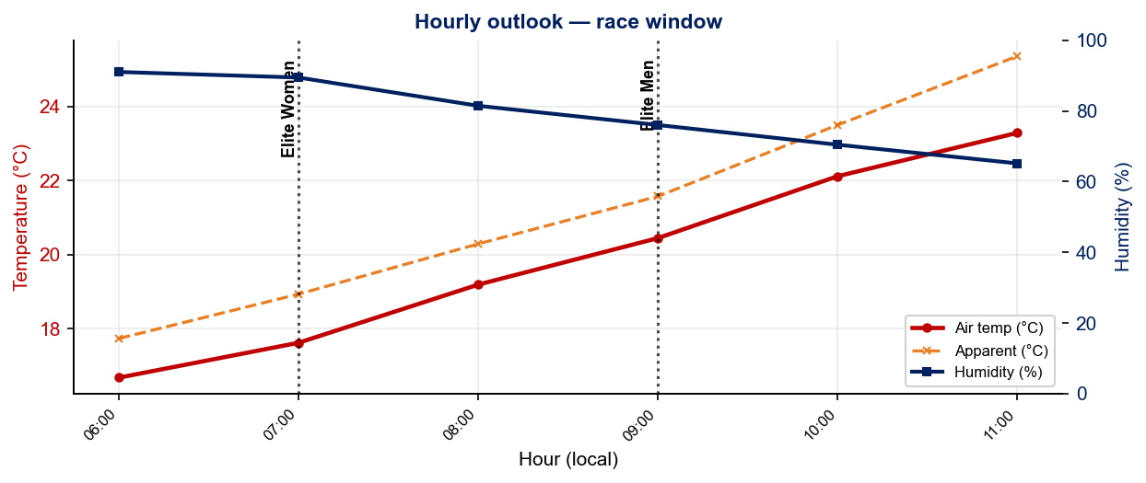
Race-Day Weather Outlook
Rio de Janeiro
2026-08-02 • Historical climatology — same calendar day, 7-year mean
Elite Women — 07:00
Temperature
Apparent / Heat
Humidity
19.1 °C
20.3 °C
82%
Wind
UV peak
Heat Stress
5.7 km/h
—
LOW
Elite Men — 09:00
Temperature
Apparent / Heat
Humidity
21.9 °C
23.5 °C
71%
Wind
UV peak
Heat Stress
5.7 km/h
—
LOW
Hydration & Cooling Cues
• Cool to mild outlook — standard fluid plan (~500 ml/h), no special pre-cooling required
• Men's race runs 2.8 °C hotter than women's — heat-acclim work + heavier cooling kit for the 08:30 start
Data source: Open-Meteo. Forecast will replace climatology once race day is within 16 days. Historical Race Conditions slide shows what actually happened in prior years.

Slide 9
Travel & Arrival Load
Denver, CO → Rio de Janeiro race week
Core travel read
Denver → Rio (GIG) is an overnight, one-stop haul — typically via ATL, IAH, MIA, or JFK/EWR on United/American/LATAM, ~13–15 h door-to-door. Only +4 h time-zone shift (MDT → BRT), so jet-lag is moderate — the bigger factor is the long overnight leg. The LOC runs a FREE airport shuttle GIG → Othon Palace Copacabana (bikes included) on July 29–31 — registration is mandatory or you self-arrange (~BRL 80–150 by Uber/99). Land by ~July 30 to settle before the Aug 1 briefing and Aug 2 race.
Primary route
Flight time
Time zones
Airport Transfer
Transfer Distance
DEN → GIG
~13–15 h
+4 h
GIG → Othon Palace
~20 km / 30–60 min
1-stop, overnight
via ATL / IAH / MIA
Rio ahead of Denver
Free LOC shuttle (register)
Traffic-dependent
Host Hotel / Accommodation Read
Food / Grocery Options Near Venue
• Official host hotel: Othon Palace Copacabana, Av Atlântica 3264 — directly facing Copacabana Beach.
• Grocery: Zona Sul and Pão de Açúcar supermarkets along/near Av Nossa Senhora de Copacabana for staples, water, fruit, snacks.
• Walking distance to the Triathlon Arena (central median of Av Atlântica, ~height 3806) — no race-morning commute.
• Bottled/filtered water only — do not drink tap water in Rio; stock sealed bottles for race week to avoid GI risk.
• Free LOC airport shuttle GIG ↔ Othon (bikes included) on Jul 29–31 / Aug 2–3 — mandatory registration via the LOC form.
• Athlete-friendly: açaí bowls, grilled meats/fish, rice-and-beans, and juice bars are everywhere — easy carb + protein, but be selective with raw/street food pre-race.
• Copacabana is dense and walkable; the beachfront promenade is the venue, training ground, and social hub in one.
• The athletes' lounge provides sealed water + fruit before/after the race; bring your own race-morning fueling from the hotel.
• Brazil entry: check current US-passport visa/ETA status well before travel — requirements have shifted recently.
• Sun + exposed beachfront: pre-stock electrolytes and high-SPF sunscreen for daily training on the sand.

Slide 10
Environmental Risk Profile
Rio de Janeiro
RACE-DAY WEATHER (07:00–11:00 local)
AIR QUALITY (Open-Meteo archive)
Year | Date | Air Temp | Humidity | Wind km/h | Precip mm
Year | PM2.5 | EU AQI | UV Index | Risk
HEALTH & WATER QUALITY RISK FACTORS
• Water Quality: [PLACEHOLDER: Historical water quality data for Rio de Janeiro — e.g. bacterial counts, EU Bathing Water Directive status, known algae / pollution events. Check local environmental agency reports for May race window.]
• Athlete Health Incidents: [PLACEHOLDER: Any known GI illness, respiratory, or heat-related incidents at this or comparable venues. E.g. Sunderland 2023 — reported GI illness post-swim for multiple athletes.]
• Water Temperature: [PLACEHOLDER: Historical open-water temperature for Rio de Janeiro in May (not available from Open-Meteo; check Copernicus Marine / NOAA or WT historical results).]
• Heat / Humidity Risk: Auto-derived from above table — flag if humidity >70% or air temp >25°C at race time.
Weather and AQ data: Open-Meteo historical archive (archive-api.open-meteo.com). EU AQI: Good ≤20, Fair ≤40, Moderate ≤60, Poor ≤80, Very Poor >80.

Slide 11
Who to Watch — Rio de Janeiro Race Week
ELITE MEN
ELITE WOMEN
Top 10 Ranked on Startlist
Top 10 Ranked on Startlist
Rank | Athlete | Points
17 | Diego Moya | 3,125
20 | Reese Vannerson | 2,911
37 | Jawad Abdelmoula | 2,532
41 | Mathis Beaulieu | 2,443
49 | Manoel Messias | 2,250
53 | Sullivan Middaugh | 2,150
54 | Luke Schofield | 2,130
55 | Braxton Legg | 2,124
63 | Kazushi Jozuka | 1,917
65 | Andree Buc | 1,889
Rank | Athlete | Points
23 | Djenyfer Arnold | 2,837
29 | Verena Steinhauser | 2,627
34 | Manami Hayashi | 2,443
37 | Danielle Orie | 2,432
41 | Erika Ackerlund | 2,208
43 | Mariana Vargem | 2,145
45 | Sophia Howell | 2,111
51 | Beatrice Mallozzi | 2,028
55 | Mako Hiraizumi | 1,998
57 | Zuzana Michalickova | 1,993
Returning Podium Athletes on Startlist
Returning Podium Athletes on Startlist
No prior race history at this venue.
No prior race history at this venue.
Rankings = current World Triathlon rankings snapshot; startlist intersect uses program_entries when available.

Slide 12
Top Swim Threats
Rio de Janeiro
Ranked by Lead Pack % (within 15 s of swim leader — robust to course speed) • EWMA swim split (span-5) shown per distance; Sprint = this race • WTCS / World Cup / Continental, last 4 yrs
ELITE MEN
ELITE WOMEN
# | Athlete | Lead % | EWMA Spr ▸ | EWMA Std | Spr/Std
1 | Aiden Longcroft-Harris | 97% | 9:12 | 17:51 | 21/8
2 | Ramón Armando Matute | 91% | 9:12 | 18:27 | 17/5
3 | Pietro Giovannini | 87% | 8:48 | 17:59 | 10/5
4 | Dylan McCullough | 86% | 8:30 | 17:25 | 14/7
5 | Diego Moya | 77% | 8:32 | 17:46 | 19/11
6 | Kevin Tarek Viñuela Gonzalez | 74% | 8:21 | 16:54 | 17/14
7 | Martin Demuth | 66% | 9:24 | 17:57 | 18/14
8 | Luigi Antonio Loddi Vanzella | 64% | 9:28 | 18:53 | 10/1
9 | Gabriel Terán Carvajal | 59% | 8:57 | 18:40 | 20/7
10 | Kauê Willy | 56% | 8:54 | 18:31 | 18/7
11 | Badr Siwane | 52% | 10:17 | 18:22 | 22/9
12 | Filip Vilenica | 50% | 8:58 | — | 4/0
13 | James Corbett | 48% | 9:40 | 18:13 | 19/12
14 | Mitch Kolkman | 47% | 9:03 | 17:26 | 15/4
# | Athlete | Lead % | EWMA Spr ▸ | EWMA Std | Spr/Std
1 | Vittoria Lopes | 100% | 10:10 | 18:56 | 8/9
2 | Kelly Wetteland | 78% | 9:34 | 20:02 | 8/1
3 | Erin McConnell | 77% | 9:28 | — | 13/0
4 | Sophia Howell | 71% | 9:49 | 19:46 | 27/8
5 | Cecilia Santamaria Surroca | 71% | 9:56 | 19:16 | 18/10
6 | Moira Miranda | 58% | 10:13 | 19:46 | 15/4
7 | Djenyfer Arnold | 52% | 10:05 | 19:32 | 9/14
8 | Tjasa Vrtacic | 50% | 9:19 | 19:03 | 14/2
9 | Hollie Elliott | 50% | 10:06 | 19:19 | 16/6
10 | Josephine Seerig | 47% | 10:15 | 20:05 | 12/3
11 | Manami Hayashi | 46% | 10:09 | 20:06 | 20/8
12 | Danielle Orie | 44% | 9:45 | 19:50 | 12/6
13 | Melanie Santos | 40% | 10:05 | 19:08 | 10/10
14 | Rafaela Capó | 40% | 10:08 | 21:12 | 6/4

Slide 13
USA World Rankings Snapshot
Rio de Janeiro
As of 2026-07-27 • World Triathlon Rankings • Heading into Rio de Janeiro • Race tier: World Cup
Max Points Available at this Race
Win
Podium
Top 5
Top 10
Top 15
Top 20
500 pts
427 pts
366 pts
247 pts
167 pts
113 pts
ELITE MEN
ELITE WOMEN
Rank | Athlete | Points | Curr | Prev
20 | Reese Vannerson | 2,911 | 6 | 6
21 | John Reed | 2,898 | 6 | 6
26 | Morgan Pearson | 2,712 | 5 | 5
48 | Seth Rider | 2,281 | 6 | 5
53 | Sullivan Middaugh | 2,150 | 6 | 6
55 | Braxton Legg | 2,124 | 6 | 6
71 | Keller Norland | 1,795 | 6 | 6
77 | Blake Bullard | 1,761 | 6 | 6
82 | Chase McQueen | 1,708 | 6 | 6
110 | Darr Smith | 1,452 | 6 | 6
112 | Zach Leachman | 1,433 | 6 | —
130 | Porter Middaugh | 1,229 | 6 | 6
168 | Carter Stuhlmacher | 1,041 | 6 | 4
278 | Cole Jamieson | 600 | 4 | 2
379 | Isaac Lamprecht | 375 | 6 | 2
Rank | Athlete | Points | Curr | Prev
8 | Taylor Spivey | 5,256 | 6 | 4
16 | Gina Sereno | 3,205 | 6 | 6
26 | Gwen Jorgensen | 2,700 | 6 | 6
37 | Danielle Orie | 2,432 | 6 | 6
41 | Erika Ackerlund | 2,208 | 6 | 6
44 | Taylor Knibb | 2,129 | 4 | 1
56 | Naomi Ruff | 1,997 | 6 | 6
64 | Kelly Wetteland | 1,843 | 6 | 3
84 | Kirsten Kasper | 1,551 | 5 | 2
85 | Joy Gill | 1,547 | 6 | 5
86 | Eleanor Beveridge | 1,544 | 6 | 6
109 | Rachel Werking | 1,302 | 6 | 2
120 | Michelle Magnani | 1,242 | 6 | 6
154 | Katie McCune | 1,042 | 6 | 1
161 | Ellison Wolfe | 1,002 | 6 | 4

Slide 14
Olympic Qualification Pace
Rio de Janeiro
Paris 2024 OQR cutoff (30th): 3,626.69 pts ÷ 12-event cap = 302 pts / event on pace
An athlete who averages ~302 pts per event across their best 12 events is on pace to clear the LA 2028 qualifying threshold.
FINISH POSITION AT EACH TIER THAT HITS 302-PT PACE
Tier | Win pts | Last on-pace pos | First off-pace pos (pts) | Verdict
World Championship Series | 1000 | #16 | #17 (287 pts) | Top 16
World Cup | 500 | #7 | #8 (290 pts) | Top 7
Continental Championships (Americas) | 590 | #9 | #10 (293 pts) | Top 9
Continental Cup (Americas) | 280 | None (win = 280) | — | Not achievable
USA MEN
USA WOMEN
Rk | Athlete | Total | Races | On | Off | Pace | Proj @12
15 | Reese Vannerson | 1,408 | 3 | 3 | 0 | 469 | 5,634
16 | Seth Rider | 1,341 | 4 | 3 | 1 | 335 | 4,023
24 | Sullivan Middaugh | 1,015 | 3 | 2 | 1 | 338 | 4,063
30 | Morgan Pearson | 904 | 2 | 1 | 1 | 452 | 5,425
35 | Chase McQueen | 816 | 4 | 1 | 3 | 204 | 2,450
41 | Braxton Legg | 774 | 3 | 1 | 2 | 258 | 3,097
50 | John Reed | 599 | 2 | 1 | 1 | 299 | 3,598
56 | Keller Norland | 519 | 1 | 1 | 0 | 519 | 6,234
57 | Blake Bullard | 513 | 3 | 0 | 3 | 171 | 2,055
92 | Zach Leachman | 212 | 1 | 0 | 1 | 212 | 2,545
103 | Cole Jamieson | 169 | 1 | 0 | 1 | 169 | 2,038
Rk | Athlete | Total | Races | On | Off | Pace | Proj @12
9 | Taylor Knibb | 2,047 | 4 | 4 | 0 | 511 | 6,142
13 | Taylor Spivey | 1,795 | 3 | 3 | 0 | 598 | 7,180
15 | Gina Sereno | 1,450 | 4 | 2 | 2 | 362 | 4,351
19 | Danielle Orie | 1,146 | 4 | 2 | 2 | 286 | 3,439
24 | Naomi Ruff | 882 | 3 | 1 | 2 | 294 | 3,530
46 | Eleanor Beveridge | 567 | 3 | 0 | 3 | 189 | 2,269
48 | Gwen Jorgensen | 556 | 2 | 1 | 1 | 278 | 3,337
58 | Kelly Wetteland | 462 | 1 | 1 | 0 | 462 | 5,550
61 | Erika Ackerlund | 407 | 2 | 0 | 2 | 203 | 2,444
76 | Rachel Werking | 271 | 2 | 0 | 2 | 135 | 1,629
96 | Joy Gill | 200 | 2 | 0 | 2 | 100 | 1,203
On = events scoring ≥ pace. Off = events < pace. Pace = total breakdown pts ÷ events raced. Proj @12 = current total + (avg pts × remaining events to cap); green if ≥ Paris cutoff. Cutoff estimate: Paris 2024 = 3,627 pts / 12 events = 302 pts/event. Tier positions use a geometric 0.925 points model. Source: World Triathlon rankings database.

